Slide 1
Neural network FOR breast cancer diagnosis
Muhammad Haris 18623

Slide 2
ABSTRACT
Neural network FOR breast cancer diagnosis
The project is based on a two-layer neural network written in Python.
The model takes as input certain health related physical attributes and predicts the diagnosis of breast cancer in patients.
The Algorithm initially trains itself on a real dataset before testing and being applied into practical purposes.

Slide 3
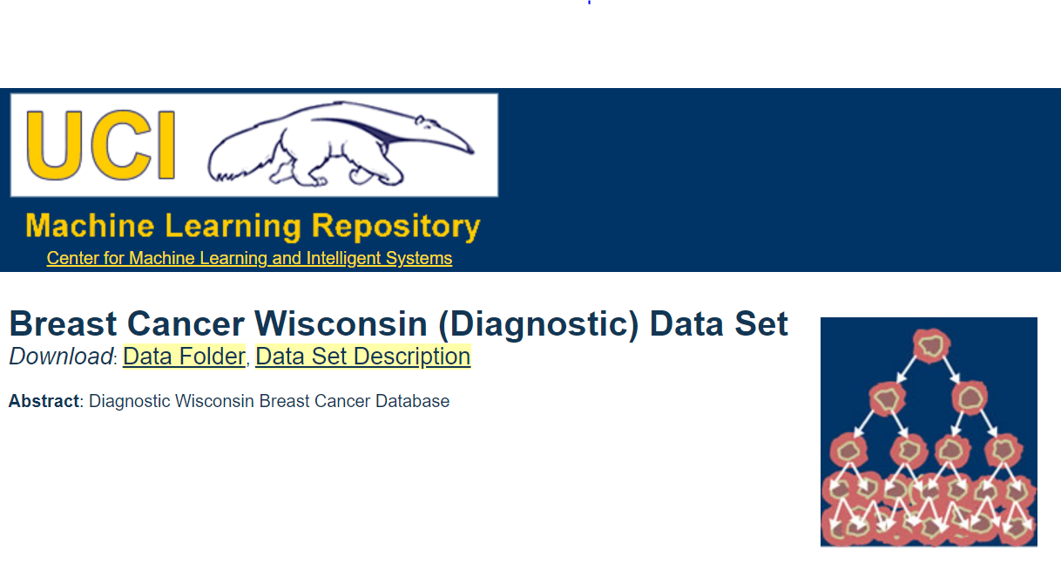
DATASET USED
URL: https://archive.ics.uci.edu/ml/machine-learning-databases/breast-cancer-wisconsin/
The data initially contains 30 features(columns) and 569 instances(rows).
All the values are Real except the diagnosis(target) value which is Categorical : B-Benign or M-Malignant. The algorithm encodes it to binary values later.
The redundancy of mean median mode is removed from the data to make the process simpler for a 2-layer network, hence it now contains only 12 features.
The values are also manually standardized with normal distribution and split into separate train and test sets before being inputted to the neural network.

Slide 4

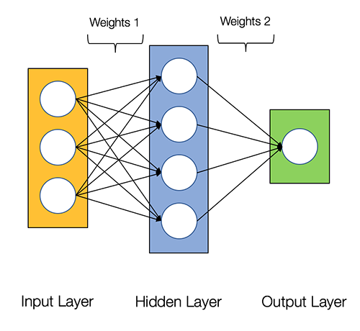
Mathematical computation: Formulas used
Input Layer: Weights are multiplied and bias is added to each of the 11 data features.
Hidden Layer: ReLu(Rectified Linear Unit) function is applied to the data.
Output Layer: Second weights and bias are applied. Then sigmoid Function is applied before the final diagnosis is predicted.
Loss Function: Binary cross entropy is used to calculate error as it is a binary classification problem(B or M).
Derivatives: Partial derivates of all the above functions.

Slide 5
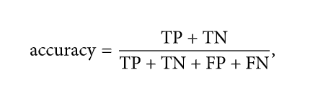
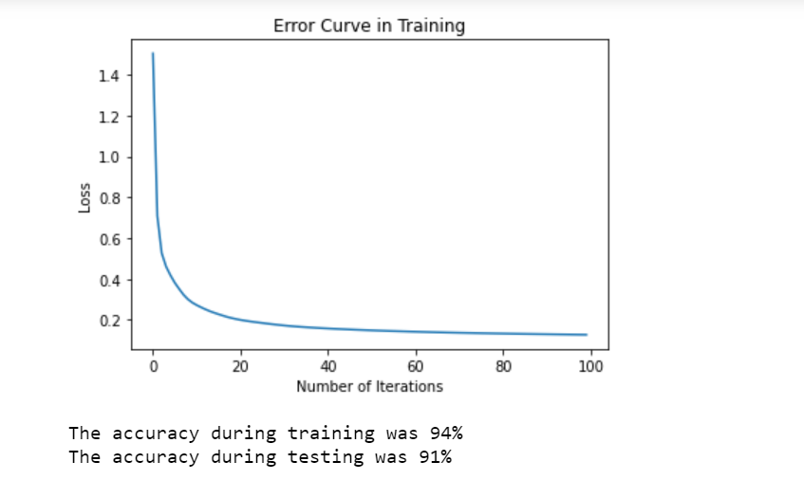
ANALYSIS
The metric used for evaluation apart from the graph is accuracy.
The algorithm was highly efficient with 91% success in diagnosing cancer accurately in patients.
Error could be further reduced by using increased number of layers, a greater number of iterations and adjusting the learning rate.

Slide 6
Real life applications
The accurate predictions made by this deep learning model can aid in automatic detection of breast cancer.
According to Paul Perkins, it is estimated that approximately 10 to 20% of all cases of cancer are misdiagnosed which can have life threatening implications.
This automatic diagnosis would mean elimination of human error in diagnosis in addition to significantly reduced cost of tests.

Slide 7
Thankyou

